Slide 2







Slide 3



rateCourse(rating) {
return
}
{ type: RATE_COURSE, rating: rating }

Slide 4






Slide 5













Slide 6


Slide 7


Slide 8












☺

Slide 9



state = {
◀
name: ‘John Doe'
role: 'author'
}
state.role = 'admin';
return state;
◀

Slide 10


state = {
◀
name: 'John Doe'
role: 'author'
}
return state = {
name: 'John Doe' role: 'admin'
}
◀
☺

Slide 11








{ ...myObj }
Object.assign
.map

Slide 12




Object.assign(target, ...sources);
Object.assign({}, state, { role: 'admin' });

Slide 13

const newState = { ...state, role: 'admin' };
const newUsers = [...state.users]

Slide 14
const user = { name: 'Cory’, address: {
state: 'California'
}
}
// Watch out, it didn't clone the nested address object! const userCopy = { ...user };
// This clones the nested address object too
const userCopy = { ...user, address: {...user.address}};

Slide 15













Slide 16

import produce from "immer" const user = {
name: "Cory", address: {
state: "California"
}
};
const userCopy = produce(user, draftState => { draftState.address.state = "New York"
})
console.log(user.address.state); // California
console.log(userCopy.address.state) // New York

Slide 17
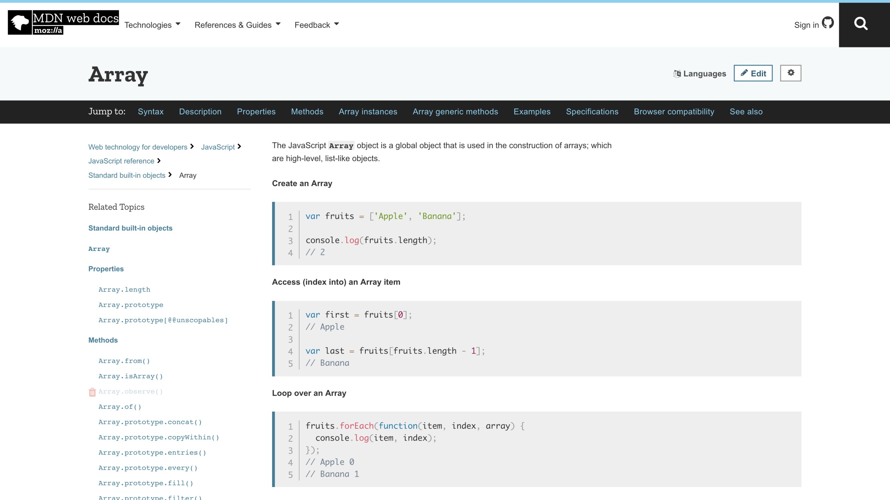

Slide 18














Slide 19













▪

Slide 20





Slide 21




▪
▪
▪

Slide 22



Slide 23




▪
▪
▪

Slide 24


state = {
name: 'Cory House' role: 'author' city: 'Kansas City' state: 'Kansas' country: 'USA' isFunny: 'Rarely' smellsFunny: ’Often'
...
}

Slide 25
if (prevStoreState !== storeState) ...

Slide 26
▪
▪
▪

Slide 27





▪
▪
▪
▪

Slide 28


Slide 29



















Slide 30


Slide 31

function myReducer(state, action) {
// Return new state based on action passed
}

Slide 32
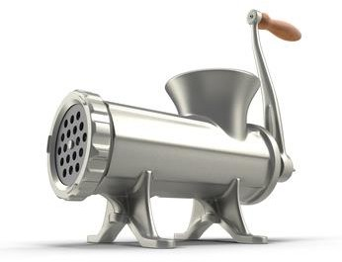


Slide 33



function myReducer(state, action) {
// Return new state based on action passed
}

Slide 34

function myReducer(state, action) { switch (action.type) {
case "INCREMENT_COUNTER":
state.counter++;
return state; default:
return state;
}
}

Slide 35
function myReducer(state, action) { switch (action.type) {
case "INCREMENT_COUNTER":
return { ...state, counter: state.counter + 1 }; default:
return state;
}
}

Slide 36


Slide 37






▪
▪
▪

Slide 39

















Slide 40
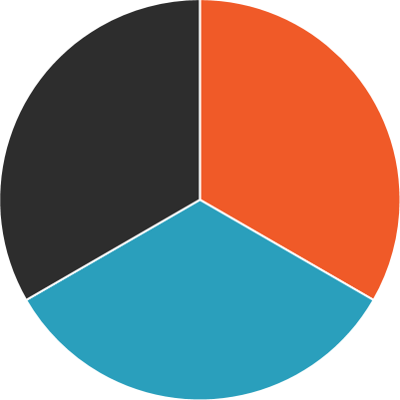





Slide 41



Slide 42












-
-
-
-
-
-
-

